Slide 1

Logistic Regression
Presented by:
Elizer Ponio Jr.
Department of Computer Science
College of Computing and Information Technologies

Slide 2
Outline
Odds and Probability
What is Logistic Regression?
Applications of Logistic Regression
Comparing Linear and Logistic Regression
Maximum Likelihood

Slide 3
Obese
Logistic Regression is similar to Linear Regression except…
Not Obese
1
2
3

Slide 4
Obese
Logistic Regression predicts whether something is True or False, instead of predicting something continuous like price.
Not Obese
1
2
3

Slide 5
Obese
These people are obese
These people are not obese
Not Obese
1
2
3
Weight

Slide 6
Obese
Instead of fitting a straight line to the data, logistic regression fits an “S” shaped logistic function
Not Obese
1
2
3
Weight

Slide 7
1
The curve goes from 0 to 1
0
1
2
3
Weight

Slide 8
1
The curve tells you the probability that a person is obese based on its weight.
0
1
2
3
Weight

Slide 9

Obese
If we weighed a very heavy person
Not Obese
1
2
3
Weight

Slide 10
Obese
There is a high probability that this person is obese.
Not Obese
1
2
3
Weight

Slide 11
Obese
If the person has an average weight
Not Obese
1
2
3
Weight

Slide 12
Obese
Then there is only a 50% chance that this person is obese.
Not Obese
1
2
3
Weight

Slide 13
Although logistic regression tells the probability that a person is obese or not, it’s usually used for classification
Obese
Not Obese
1
2
3
Weight

Slide 14
For example, if the probability of a person is greater than 50%, then we will classify it as obese, otherwise we will classify it as not obese
Obese
Not Obese
1
2
3
Weight

Slide 15
Just like Linear Regression, we can make a simple model..
Using only weight to predict Obesity
Obese
Not Obese
1
2
3
Weight

Slide 16
Or more complicated models..
Using weight, height, age and blood type to predict obesity
Obese
Not Obese
1
2
3
Weight

Slide 17
In other words, just like linear regression, logistic regression can work with continuous data (weight, height, age) and discrete data (blood type)
Obese
Not Obese
1
2
3
Weight

Slide 18
Logistic Regression’s ability to provide probabilities and classify new samples using continuous and discrete data makes it a popular machine learning method.
Obese
Not Obese
1
2
3
Weight

Slide 19
One big difference between linear and logistic regression is how the line is fit to the data
Obese
Not Obese
1
2
3
Weight

Slide 20
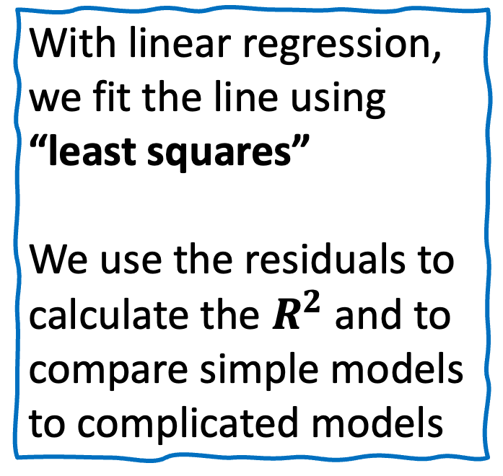
With linear regression, we fit the line using “least squares”
We use the residuals to calculate the $R^{2}$ and to compare simple models to complicated models
Jeepney Fare (Y)
Price of Fuel (X)

Slide 21
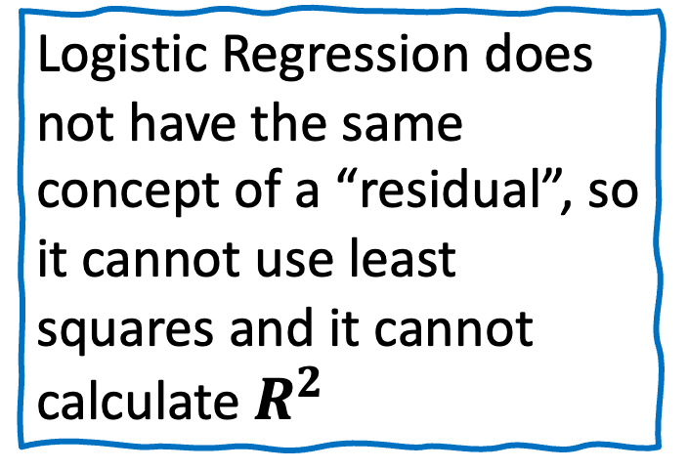
Logistic Regression does not have the same concept of a “residual”, so it cannot use least squares and it cannot calculate $R^{2}$
Obese
Not Obese
1
2
3
Weight

Slide 22
Instead, it uses something called “Maximum Likelihood”
Obese
Not Obese
1
2
3
Weight

Slide 23
Probability of passing an exam (Y)
Weight

Slide 24
Probability of passing an exam (Y)
Threshold Value
Weight

Slide 25


Probability
$$P\left(x\right)=ℙ \left(y \right| x)$$
$P(x)=β_{1}\left(x\right)+β_{0}$
This is unbounded. This will give values greater than 1 and less than 0.
We need to get probabilities between 0 and 1
Result (Y)
Hours of Study (X)

Slide 26
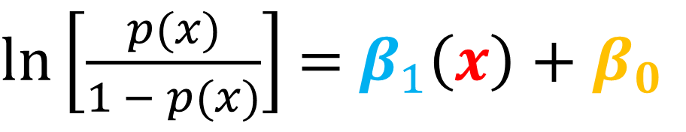
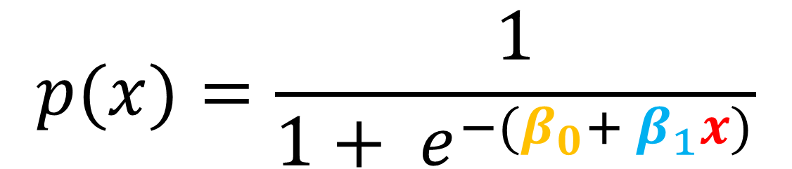
Probability
$\ln\left[\frac{p(x)}{1 − p(x)}\right]$ = $β_{1}\left(x\right)+β_{0}$
$$p(x)=\frac{1}{{1+ e}^{−(β_{0}+ β_{1}x)}}$$

Slide 27
Logistic Regression
Logistic Regression is a statistical algorithm often used for classification and predictive analytics.
Logistic regression estimates the probability of an event occurring based on a given dataset of independent variables.
Its output is 0 or 1.

Slide 28
Logistic Function
The name “logistic regression” is derived from the concept of the logistic function that it uses.
The logistic function is also known as the sigmoid function.
The value of this logistic function lies between 0 and 1, which cannot go beyond this limit, so it forms a curve like an “S” form.

Slide 29

What is Logistic Regression?
Applications of Logistic Regression
Comparing Linear and Logistic Regression
Maximum Likelihood

Slide 30
Applications
Predicting whether a user will subscribe
Predicting whether a patient will survive

Slide 31
What is Logistic Regression?
Applications of Logistic Regression
Comparing Linear and Logistic Regression
Maximum Likelihood

Slide 32
Linear Regression vs Logistic Regression
Linear Regression | Logistic Regression
It is used for solving regression problems | It is used for solving classification problems
We predict the value of continuous variables | We predict the value of categorical variables.
We find best fit line. | We find S-Curve.
Least square estimation method is used for estimation of accuracy. | Maximum likelihood estimation method is used for estimation of accuracy.

Slide 33
Linear Regression
Logistic Regression

Slide 34
Grade
Hours of Study

Slide 35
Probability of passing an exam (Y)
Hours of study

Slide 36
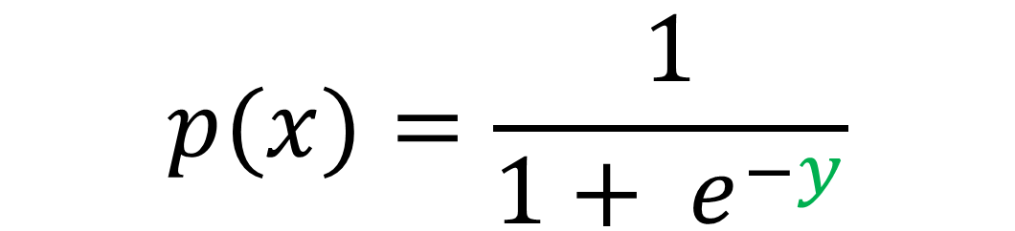
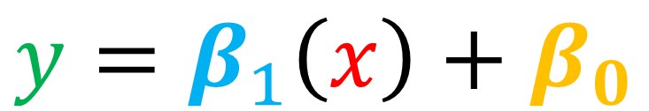
Logistic/Sigmoid Function
$$y=β_{1}\left(x\right)+β_{0}$$
$$p(x)=\frac{1}{{1+ e}^{−y}}$$

Slide 37
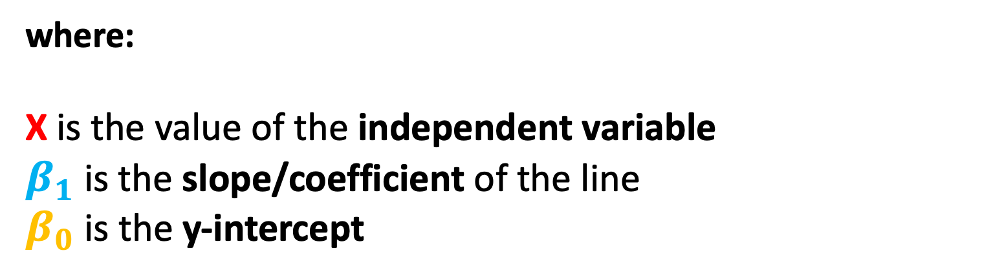
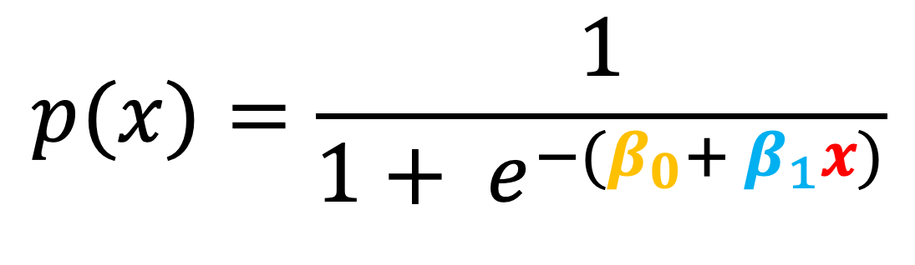
Logistic/Sigmoid Function
$$p(x)=\frac{1}{{1+ e}^{−(β_{0}+ β_{1}x)}}$$
where:
X is the value of the independent variable
$β_{1}$ is the slope/coefficient of the line
$β_{0}$is the y-intercept

Slide 38

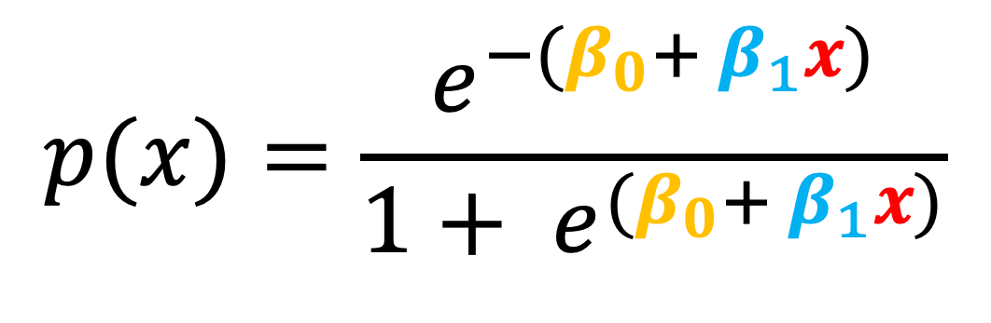
Logistic/Sigmoid Function
$$p(x)=\frac{e^{−(β_{0}+ β_{1}x)}}{{1+ e}^{(β_{0}+ β_{1}x)}}$$
where:
X is the value of the independent variable
$β_{1}$ is the slope/coefficient of the line
$β_{0}$is the y-intercept

Slide 39
What is Logistic Regression?
Applications of Logistic Regression
Comparing Linear and Logistic Regression
Maximum Likelihood

Slide 40
Maximum Likelihood Estimation
Maximum likelihood estimation is a method that determines values for the parameters of a model.
The parameter values are found such that they maximize the likelihood that the process described by the model produced the data that were actually observed.
In Logistic Regression, MLE is used as the Cost Function.

Slide 41
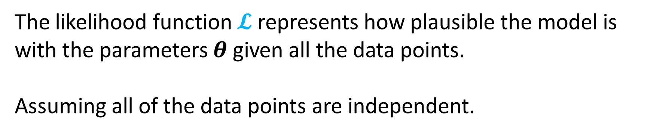
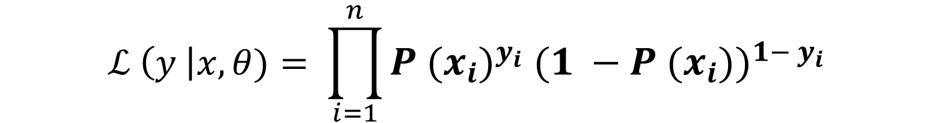
Maximum Likelihood
$ℒ \left(y \right|x, θ)= ℙ$ $\left(y_{1} \right|x_{1} β) ∗ℙ \left(y_{2} \right|x_{2} β)…∗ ℙ$ $\left(y_{n} \right|x_{n} β)$
$$ℒ \left(y \right|x,θ)= \prod_{i=1}^{n}{P {{(x}_{i})}^{y_{i}} {(1 −P (x_{i}))}^{1− y_{i}}}$$
The likelihood function $𝓛$ represents how plausible the model is with the parameters $θ$ given all the data points.
Assuming all of the data points are independent.

Slide 42
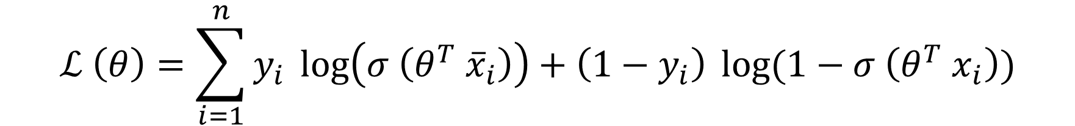

Log Likelihood
$$ℒ (θ)= \prod_{i=1}^{n}{P {{(x}_{i})}^{y_{i}} {(1 −P (x_{i}))}^{1− y_{i}}}$$
$$ℒ \left(θ\right)=\sum_{i=1}^{n}{y_{i}} \log\left(σ \left(θ^{T} {\overline{x}}_{i}\right)\right)+\left(1−y_{i}\right) \log{(1−σ \left(θ^{T} x_{i}\right))}$$

Slide 43
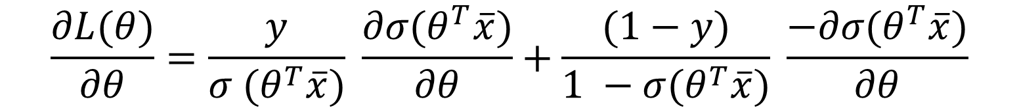
Gradient Ascent
$$\frac{∂L(θ)}{∂θ}=\frac{y}{σ (θ^{T}\overline{x})} \frac{∂σ(θ^{T}\overline{x})}{∂θ}+\frac{(1−y)}{1 −σ(θ^{T}\overline{x})} \frac{−∂σ(θ^{T}\overline{x})}{∂θ}$$
$$\frac{∂L(θ)}{∂θ}=\left(y−p \left(x\right)\right) \overline{x}$$
$$\frac{∂L(θ)}{∂θ}=\left(y−σ (θ^{T}\overline{x})\right) \overline{x}$$
Get the derivative of the log likelihood with respect to theta $θ$

Slide 44
Gradient Ascent
$$θ^{+} = θ^{−}+ α (\frac{∂L(θ)}{∂θ})$$
$$θ^{+} = θ^{−}+ α\left(y−p \left(x\right)\right) \overline{x}$$
Equation to update the logistic regression model parameters $θ$

Slide 45
References
https://www.youtube.com/watch?v=ARfXDSkQf1Y
https://www.youtube.com/watch?v=yIYKR4sgzI8&list=PLblh5JKOoLUKxzEP5HA2d-Li7IJkHfXSe&index=1
https://lottotips888.blogspot.com/p/grand-lotto-655.html

